Slide 1
Failed Banking Transaction Analysis
Ingesting, Cleaning, Processing & Visualizing Failed Transactions on Google Cloud

Slide 2
Introduction
This project focuses on developing a scalable cloud-based system that ingests banking transaction data from multiple CSV files, cleans and processes the data using PySpark on a Google Cloud Dataproc cluster, stores failed transactions in Cloud SQL, and enables data analysis through BigQuery for insights and visualization.

Slide 3
01
Project Overview

Slide 4
Objective of the Project
Automate ingestion of CSV transaction data from multiple bank branches and cities
Clean and merge data using PySpark
Filter and extract failed transactions
Store processed data in Cloud SQL
Enable advanced analytics and visualization in BigQuery

Slide 5
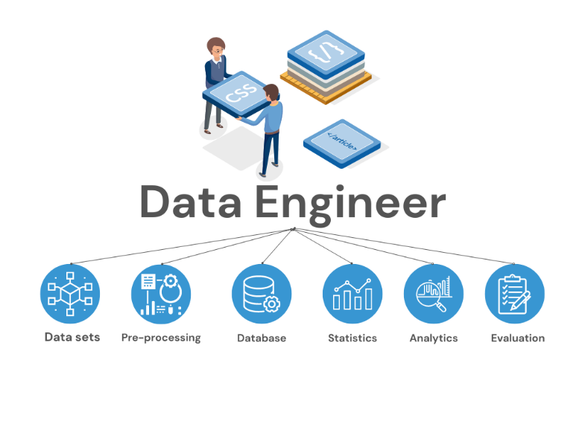
Tools and Technologies Used
Languages: Python, SQL
Frameworks: PySpark
Platforms: Google Cloud Platform (GCP)
Services: Cloud Storage, Dataproc, Cloud SQL (MySQL), BigQuery
Tools: gsutil, SparkSession, JDBC

Slide 6
Project Workflow Overview
CSV files uploaded to GCP Cloud Storage via gsutil
PySpark job runs on Dataproc single-node cluster
Null or blank rows removed
Cleaned data saved as consolidated CSV
Failed transactions filtered using PySpark
Result stored in Cloud SQL
Connected to BigQuery for visualization

Slide 7
Data Ingestion & Cleaning
Files from 3 cities × 5 branches
Files uploaded to GCP bucket using gsutil
PySpark reads all files, removes null and blank rows
Combined into a single clean CSV file

Slide 8
Filtering Failed Transactions
PySpark filters transactions where status = 'FAILED’
Only relevant columns are extracted
Result stored using JDBC into Cloud SQL (MySQL)

Slide 9
Data Storage & BigQuery Integration
Cloud SQL table holds failed transactions
BigQuery reads data using federated queries or data connectors
Enables detailed analysis and visual dashboards

Slide 10
Analysis and Visualization
Time-based failure spikes
Branch/city-wise failure rate
Transaction type vs failure rate
BigQuery with Google Data Studio or Looker Studio

Slide 11
Conclusions
This project delivers a complete cloud data pipeline for failed transaction monitoring. Using PySpark and GCP services, it ensures real-time processing, secure storage, and accessible insights for strategic decision-making in banking operations.

Slide 12
Thank you!

